Slide 1
IMAGE PROCESSING SOFTWARE

Slide 2
Introduction
The purpose of this software is to enhance video content through real-time or file-based processing, focusing on face detection, privacy-preserving face blurring, and automatic lighting adjustments
It also provides video stabilization using Optical Flow, Moving Average, and Feature-Based techniques, allowing for smooth and professional-quality output
The app is user-friendly, enabling customizable options for efficient video enhancement and secure content processing.

Slide 3
Technical architecture
COMPONENTS:
Tkinker GUI:For interactive controls and settings.
OpenCV: for video processing: Face detection, stabilization, adjustments.
Multi-threading: Keeps video feed smooth while processing in the background.

Slide 4
Face detection
Objective:Detect and outline faces in real-time video streams to enable privacy protection or analytics.
Utilizes Haar Cascade Classifiers in OpenCV.
Haar Cascade Classifiers: Fast and efficient, using pre-trained XML files to detect faces by matching patterns of grayscale intensity.

Slide 5
Face Blurr
Objective: Apply a blur effect over detected faces to maintain privacy without affecting the rest of the video.
Implementation Details:
Once faces are detected, Gaussian Blur is selectively applied to those regions, creating a smooth and visually discrete effect over the face.
The intensity of the blur can be adjusted to meet privacy requirements, allowing the feature to adapt to different scenarios.
Ensures privacy by anonymizing faces while preserving other details.

Slide 6
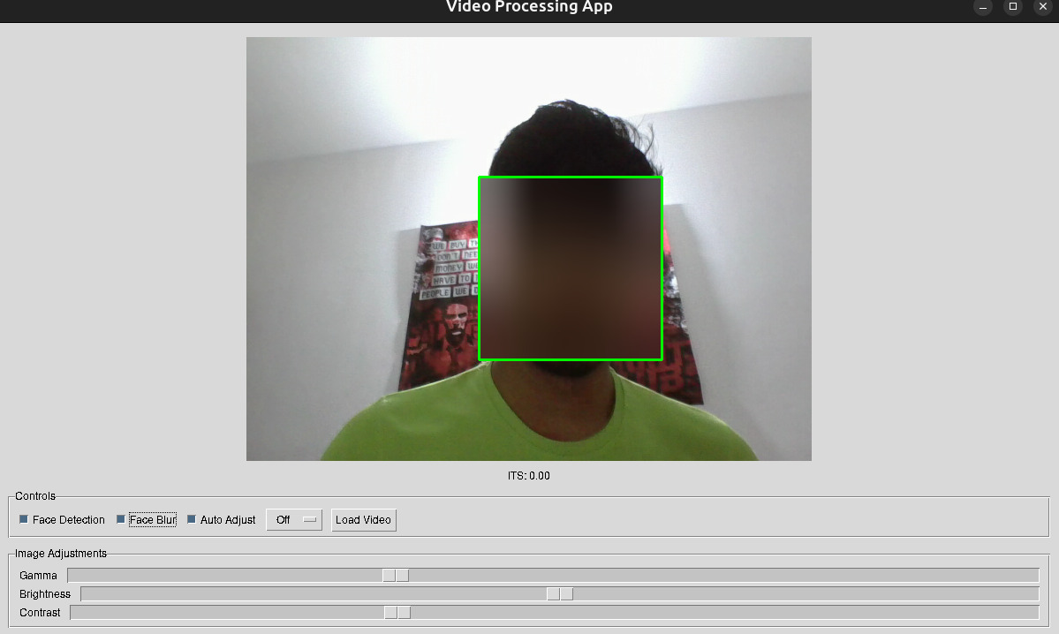
Face detection without stabilization

Slide 7
Auto adjustment
Objective: Dynamically adjusts brightness, contrast, and gamma based on lighting.
Mechanism:
Reads frame brightness and adjusts settings within optimal ranges.
Ideal for low-light or overexposed environments.

Slide 8
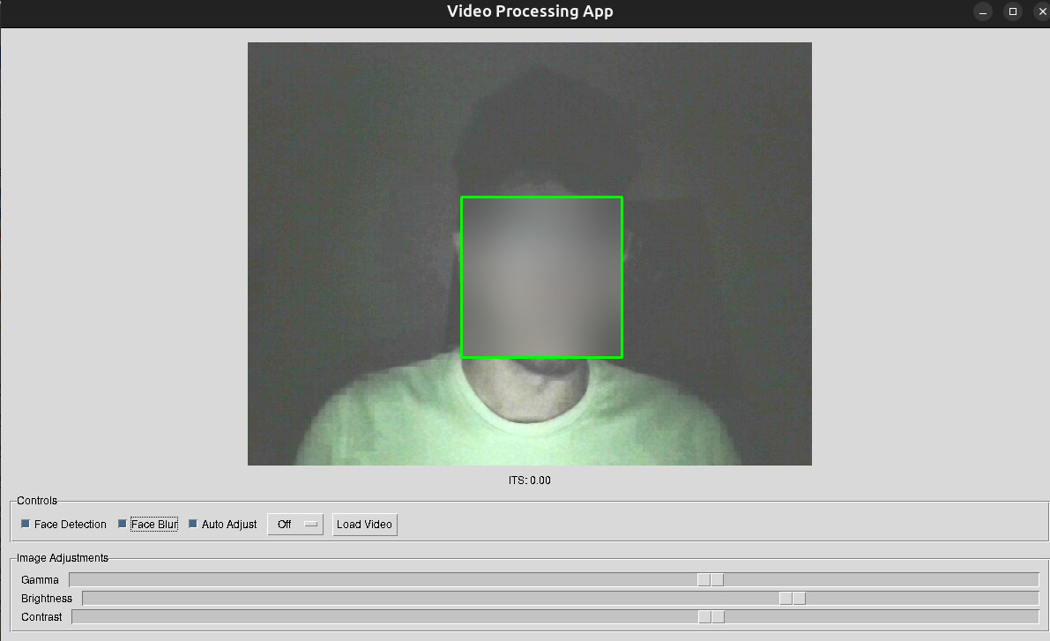
Auto adjustment

Slide 9
Stabilization techniques
Purpose: To reduce video shakiness for a smoother visual experience.
Stabilization Methods:
Three options provided: Optical Flow, Moving Average, and Feature-Based.
Each technique balances performance and quality based on specific use cases.

Slide 10
Optical Flow Stabilization
Definition: Tracks the movement of points between frames to correct motion.
Implementation:
Uses Lucas-Kanade Optical Flow method in OpenCV.
Calculates the displacement of points and adjusts frames accordingly.
Advantages:
Effective for videos with small, smooth movements.
Limitations:
May struggle with large, abrupt movements or fast-paced videos.

Slide 11
Moving Average Stabilization
Definition: Smoothens video by averaging frame positions over time.
Mechanism:
Computes the average displacement over a window of frames.
Reduces sudden jitters by applying a rolling average to frame positions.
Advantages:
Simple and fast, ideal for stable yet moderate improvement.
Limitations:
Less effective for complex movement or rotation correction.

Slide 12
Feature Based Stabilization
Definition: Uses distinctive feature points to stabilize the video.
Implementation:
Detects keypoints and matches them across frames.
Realigns frames based on stable feature points using homography.
Advantages:
Provides robust stabilization, handling rotations and larger motions.
Limitations:
Computationally intensive, may slow down real-time processing.

Slide 13
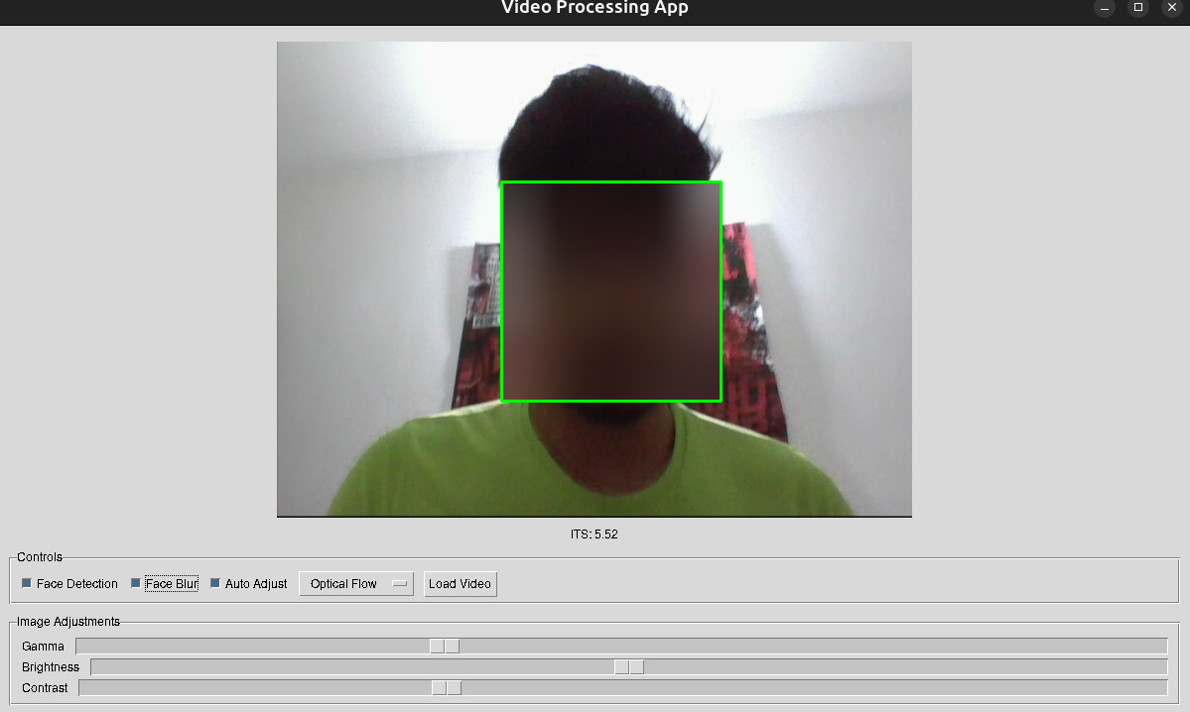
Face detection with stabilization

Slide 14
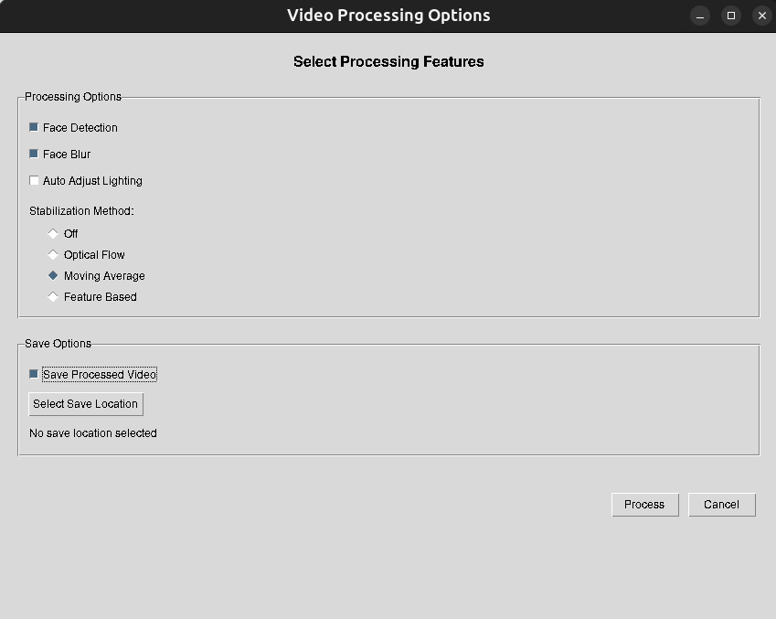
Dialog box for saving video

Slide 15
Results
ITS (Instantaneous Translation Score) measures the degree of unwanted movement between frames. Lower ITS score suggests smoother, more stable frames.
Below are the avg ITS for a particular video.
 | Optical Flow | Moving Averages | Featured Based
Avg ITS | 0.41 | 295.43 | 4.31

Slide 16
THANK YOU

